Slide 1
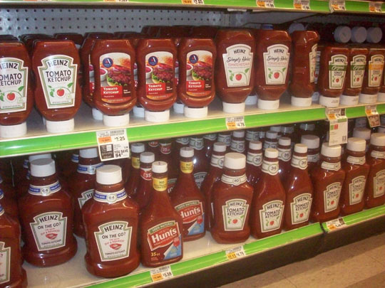
Marketing Predictive Analytics
- Pranesh Narayanan
Mustard Ketchup Analysis

Slide 2

Objective
Analyzing the market structure of competing brands
Analyzing Product sales by Dollar Value, Volume, Package Size and Markets
Brand Switching Patterns
Sales Drivers Analysis- Understanding the product dynamics driving total sales for the product
RFM Analysis to understand different customers and their shopping patterns
Understanding various Marketing Mix approach that drives the sales for a particular brand

Slide 3
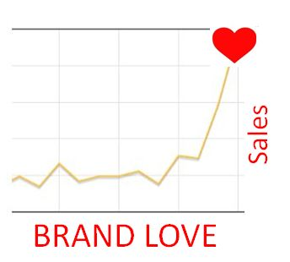
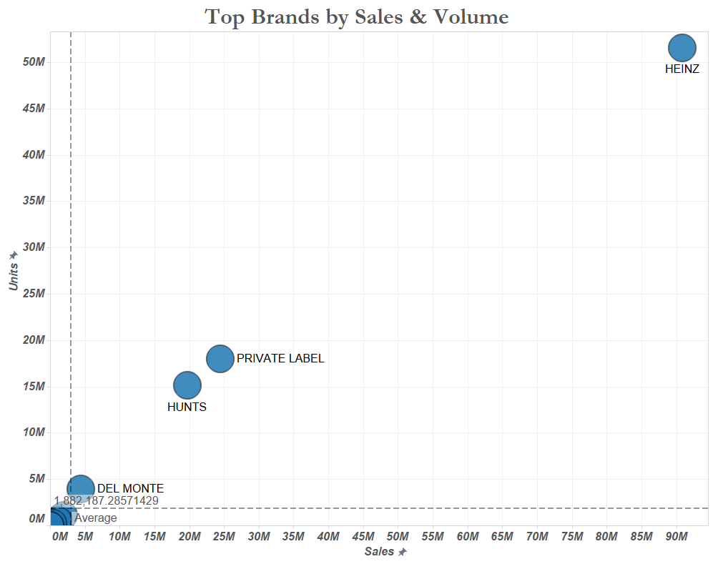
Brand Dynamics (Descriptive Analysis)
Brand Sales Pattern
By Dollar Sales
By no. of Units
Top brands
Heinz
Private Labels
Hunts
Del Monte

Slide 4


Brand Switchability (Diagnostic Analysis)
Brand Switching Patterns
Brands | HEINZ | DEL MONTE | HUNTS | OTHERS
HEINZ | 74.06% | 2.08% | 7.40% | 16.45%
DEL MONTE | 31.57% | 24.32% | 14.35% | 29.76%
HUNTS | 30.37% | 6.30% | 42.24% | 21.09%
OTHERS | 31.69% | 3.45% | 8.76% | 56.10%
Heinz has highest customer loyalty
Del Monte customers are least brand loyal and are more likely to switch compared to Heinz or Hunts
If a customer using DelMonte, Hunts & ‘Other’ brands switches, he/ she is most likely to switch to Heinz

Slide 5
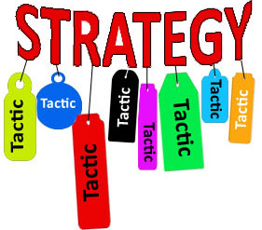
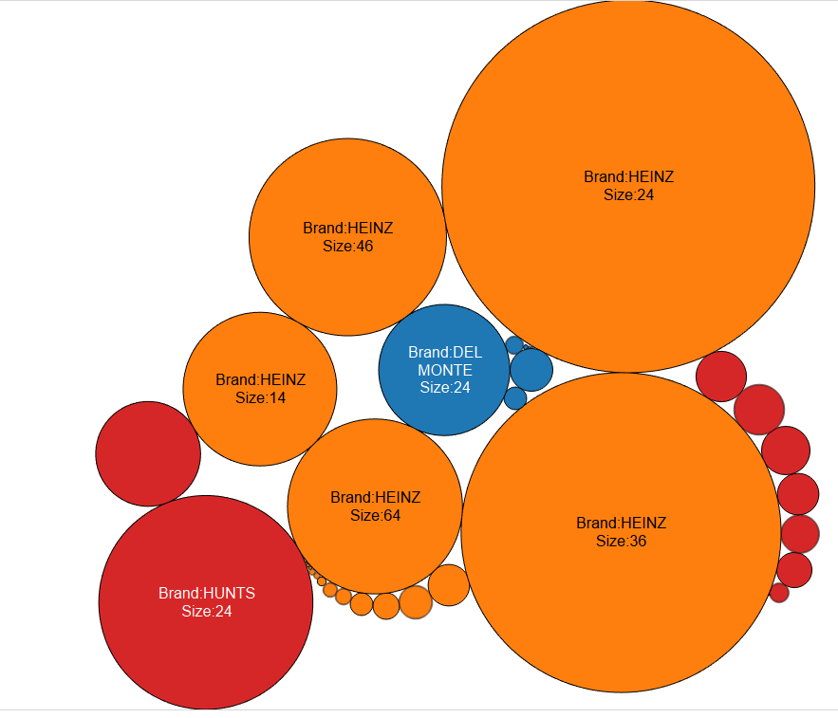
Sales Drivers Analysis
Top Selling Brand: HEINZ (followed by Hunts & Delmonte)
Top selling size: 24 oz. (followed by 36 oz.)
Analysis?
Consult for Hunts and create strategies in order to improve the market share?
Techniques?
RFM ANALYSIS to target different customer segments
PANEL ANALYSIS to analyze different marketing mix

Slide 6

RFM Analysis- Process Flow
What are the product dynamics driving total sales for the product?
24 oz. & 36 oz. most selling sizes
How many households are buying ketchup?
Measure: Household Penetration
How recently is each household buying?
Measure: Buying Recency
How often do they buy?
Measure: Purchase Frequency
How much do they buy at one time?
Measure: Purchase Size
Objective
Analyze if demographics affect brand choice
Analyze if demographics influence product choice (24 or 36 oz.)

Slide 7
RFM Analysis- Process Flow (cont.)
Data Cleaning & Manipulation for Demos Data- missing values & high null values attributes are removed
Applying Proc Factor to analyze multi- collinearity
Feature Selection to remove highly correlated attributes
Merged Data Set
Brand
Heinz
Delmonte
Product
24
Hunts
36
Demos + Panel + Grocery + Product
4) Calculate R, F & M across the 5 subsets & Rank the PANIDs across R, F & M
5) Weights assigned for these 3 individual ranks to calculate a weighted score & Rank again to sort the modified score

Slide 8
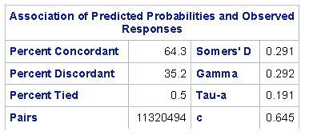
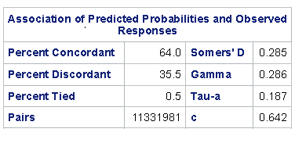
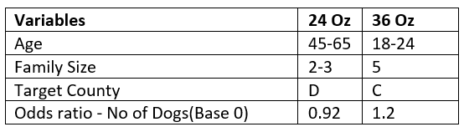
RFM Analysis- Process Flow (cont.)
6) 5 different datasets ranked based on –
Ranked from 0-2 indicating Heinz customers from low to high
Ranked from 0-2 indicating Hunts customers from low to high
Ranked from 0-2 indicating Del Monte customers from low to high
Ranked from 0-2 indicating his buy for 24 Oz ketchup product
Ranked from 0-2 indicating his buy for 36 Oz ketchup product
7) Ordered Logistic Regression with “Final Rank” as dependent
24 oz.
36 oz.
8) Selected the customers with Rank= 2 (best customers) across all 3 brands
9) Trend measured against the demographics variables that provided information to help in distinguishing 24 Oz and 36 Oz customers

Slide 9
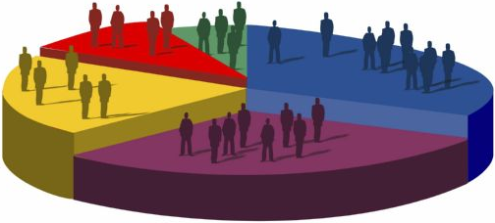
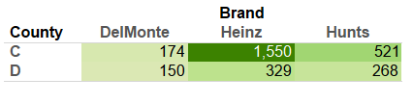
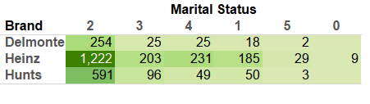
Demographics Analysis/ Insights
County
County D: Market Share is not varying much
County C: Heinz is market leader
County C seems to be the potential market for Hunts. Delmonte should have proper strategy for this market as majority of the target customers are in county C
Marital Status
Focus marketing on customers with Marital Status = 2 (Married) as majority of the customers belong to this segment
Try to increase market share across Single (1). Can target 18-24 years segment as they buy 36oz. bottles
0 = 'N/A'
1 = 'Single'
2 = 'Married'
3 = 'Divorced'
4 = 'Widowed'
5 = 'Separated'

Slide 10
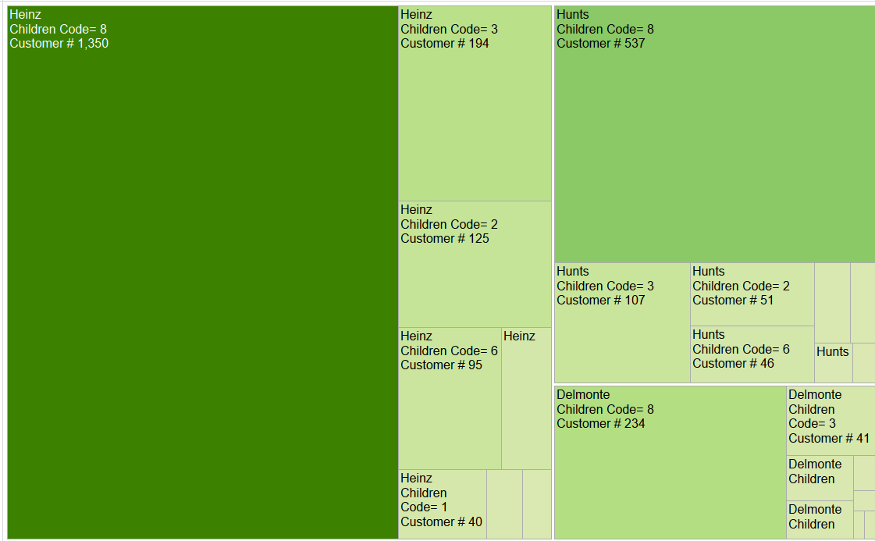
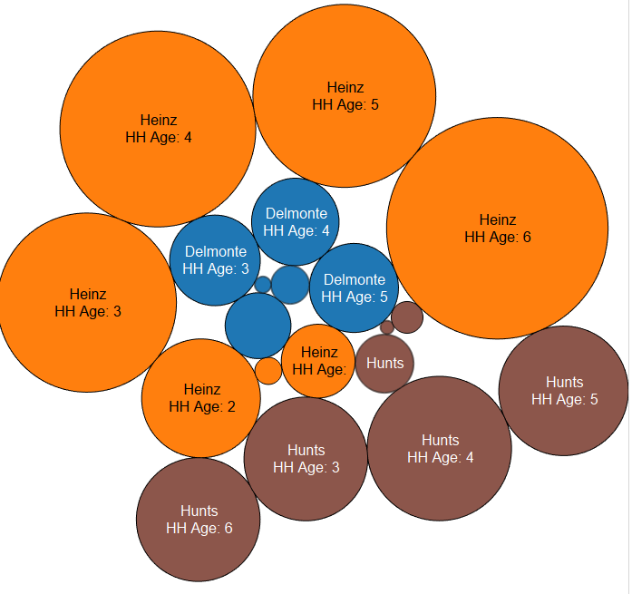
Demographics Analysis/ Insights
Children
Ideal target group is 8 (family > 0, but 0 children). These basically are married people with no children
HH Age
3, 4, 5 & 6 are the ideal ketchup target age (i.e age > 35 years)
Hunts have decent market share across 35-65 years age segment. They can also focus on age> 65+ years customer segment

Slide 11
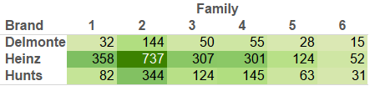
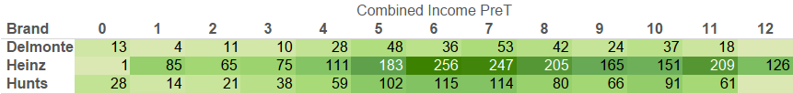
Demographics Analysis/ Insights
Family Size
Family Size=2 (married with no kids) is the most valuable customers
Focus shall be also on family size=1, as they can be a good potential customer segment
Combined Income
Majority Customers between $25000- 55000
There is close to 7% decrease than average of Hunts in the age group – [75,000 – 100,000]. This is less price sensitive & more brand focused customer segment segment

Slide 12
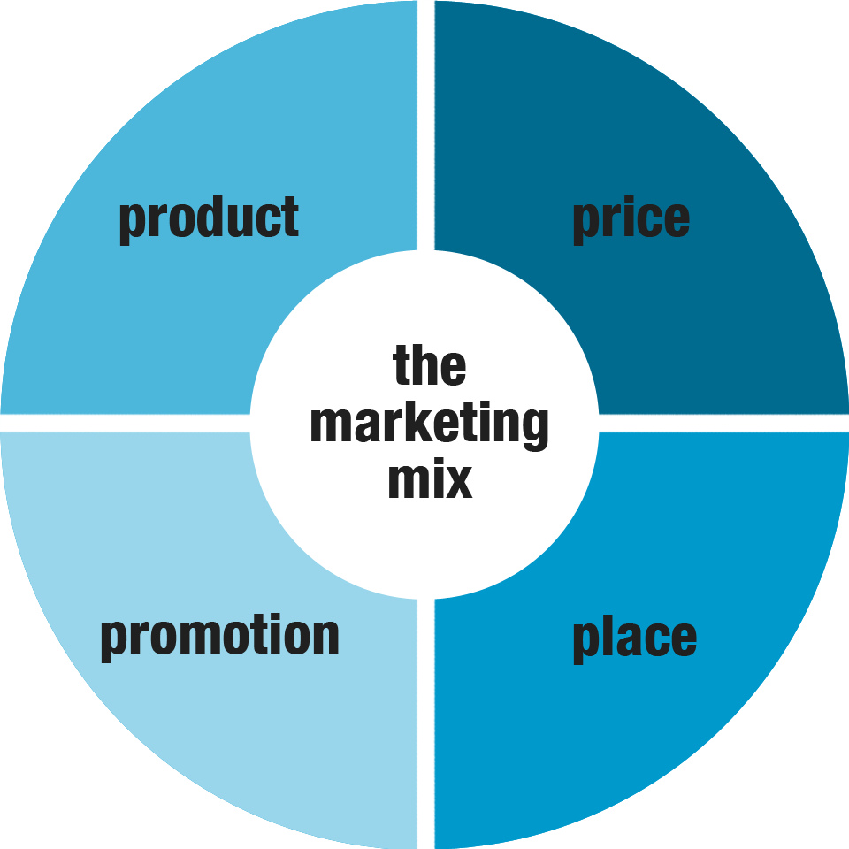
Marketing Mix
Top Selling Brand: HEINZ (followed by Hunts & Delmonte)
Question?
Analyze how Hunts promotions like feature display, price reduction and advertisements and those of competitors (Heinz and Del Monte) are affecting sales at Retail Level across different regions
Dependent Variable
No of Units sold
Independent Variables
Price Reduction
Feature
Display
Market Name
Month
Technique
Panel Data Regression
Self & Competition

Slide 13

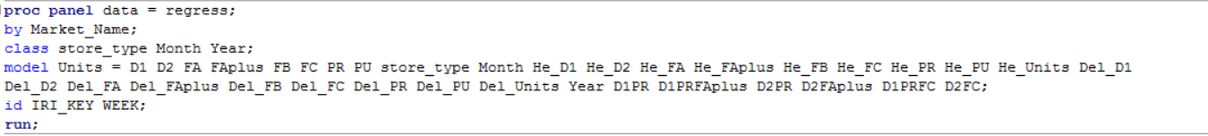
Panel Data Regression- Process Flow
Data Merge: Delivery stores + Product Data for 3 brands (Heinz, Hunts, DelMonte) across 2 sizes (24 oz. & 36 oz.)
Data Split for 24 oz. & 36 oz. to understand the influence of sales individually eliminating the IIA and selection effect
Dummy Variable creation & factor level cleaning
Panel Data Regression
5. IRI_KEY was used as panel Id and Week was used for time Id
6. Store_type was introduced to size of the store on sales of the product
7. RANTWO effect was used to model since we wanted to model for time-invarying variables too and were looking to model only for random intercepts
8. Interaction variables between price reduction, feature and display were included in the model to account for Interaction effect

Slide 14

Panel Data Insights
Separate model for every region
This model has been developed with Hunts as target brand and Heinz and Del Monte as competitors and across both products 24 Oz and 36 Oz Individually
From the Rsq obtained from modelling across each region, we can understand how sensitive the given market is to the promotional campaigns:
R-sq > 0.5: more than 50% of the sales of Hunt’s product region can be accounted from just analyzing the promotional behavior of the competitors
It is a highly promotional sensitive market and hunts will need to keep a watch on these markets and consistently update their promotional strategies
0.3< R-sq < 0.5: medium promotional sensitive market
R-sq <0.3: low promotional sensitive market

Slide 15
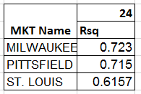
Panel Data Insights
2) Rsq values as high as 0.723 have been obtained(MILWAUKEE) which goes on to say how important promotions are in some regions to predict sales
Post basic analysis, regression model for every region also is obtained to understand how feature, display and price can be varied to improve sales
3) Milwaukee, Pittsfield and St.Louis seem to be the most promotional sensitive regions as far as 24 Oz. Hunts product is concerned
4) Sacramento has a high R-sq value of 0.8 across 36 Oz Hunts product, but is ignored because the number of records in this region to analyze the model is very low and hence will be a skewed interpretation

Slide 16
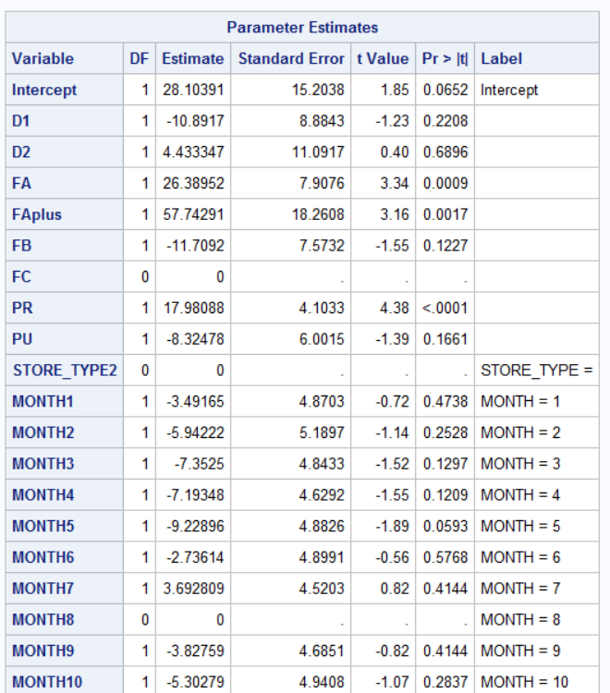
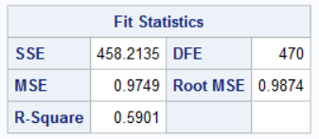
Panel Data Insights
Based on the intercept values on each region to improve sales, analysis can be done
For example in the Market_Name = SYRACUSE
D2, FA & FAplus are improving the sales
For Synacuse, 8th month is taken as base level. July & August recorded the maximum sales
D1= -11. Negative since benefits for D1 are captured in the interaction variable D1PR. Hence, there is an increase in sales/ week when D1 is considered

Slide 17
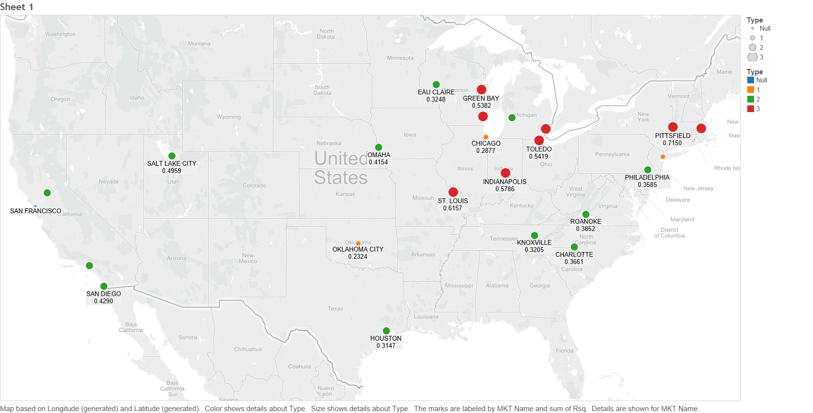
Panel Data Insights
In addition to this, recommendations can be made based on the intercept values on each region to improve sales

Slide 18

Conclusions & Recommendations
By accurately identifying the target demographics, Hunts can target potential customer segments at reduced costs and increased Lift
Identifying promotional sensitivity across the regions will help us budget the promotional expenses and forecast the sales; thereby efficiently planning finance and inventory
24 oz. bottles are the maximum selling package size, but 36 Oz bottle is catching up. With just an year, Hunts has captured a good share of 36 Oz market. This trend needs to be maintained
Married customers with no children tend to buy the maximum amount of ketchup
Across all markets Milwaukee, Pittsfield and St. Louis are most sensitive to promotions. This pattern displays the importance of promotions in some regions for better sales

Slide 19


